Slide 1

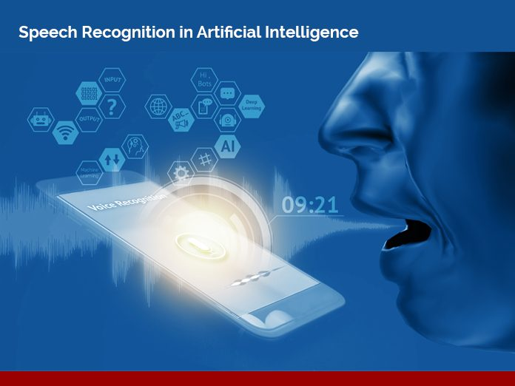
Speaker identification

Slide 2
What’s in it for you?
Speech identification process
KNN algorithm
Results
References

Slide 3
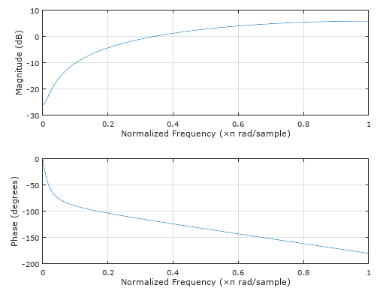
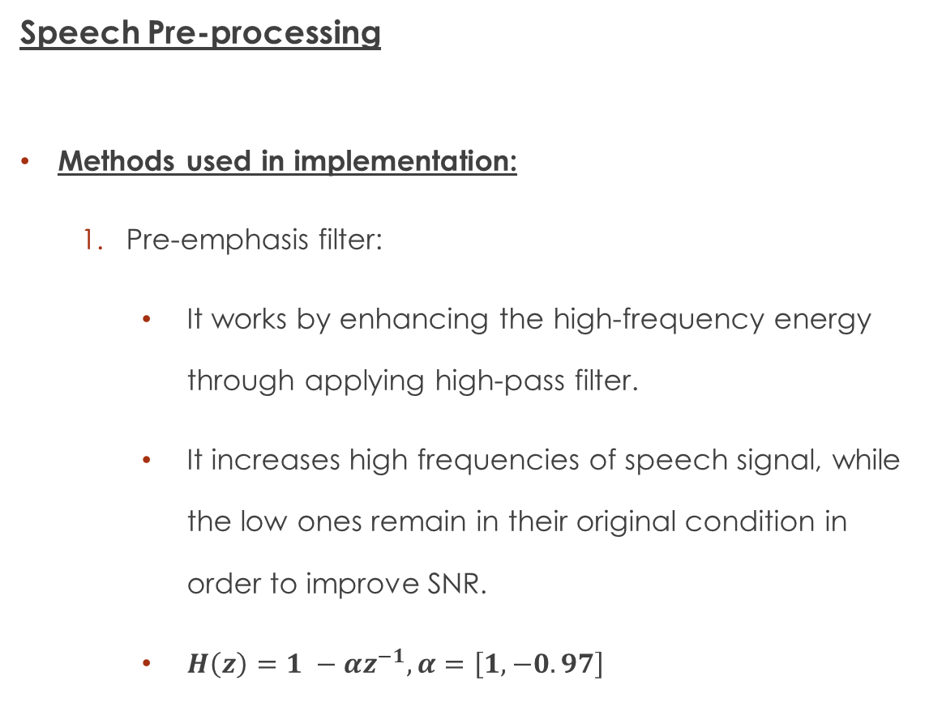
Speech Pre-processing
Methods used in implementation:
Pre-emphasis filter:
It works by enhancing the high-frequency energy through applying high-pass filter.
It increases high frequencies of speech signal, while the low ones remain in their original condition in order to improve SNR.
$H\left(z\right)=1 −αz^{−1}, α=\left[1, −0.97\right]$
Figure: Frequency response for Pre-emphasis filter

Slide 4
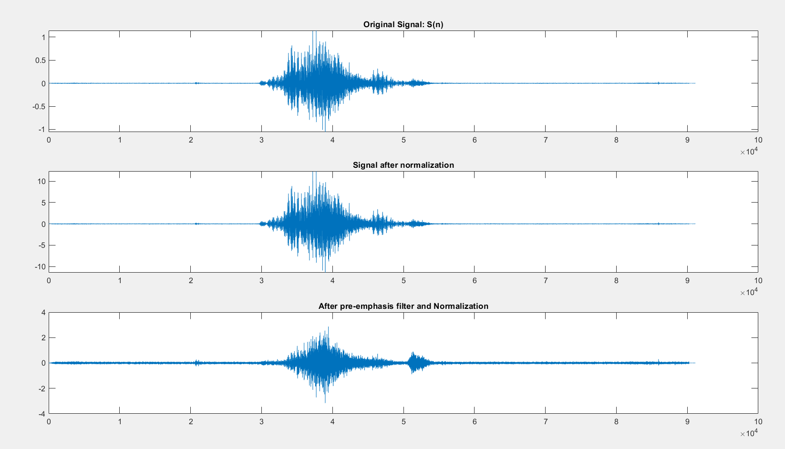
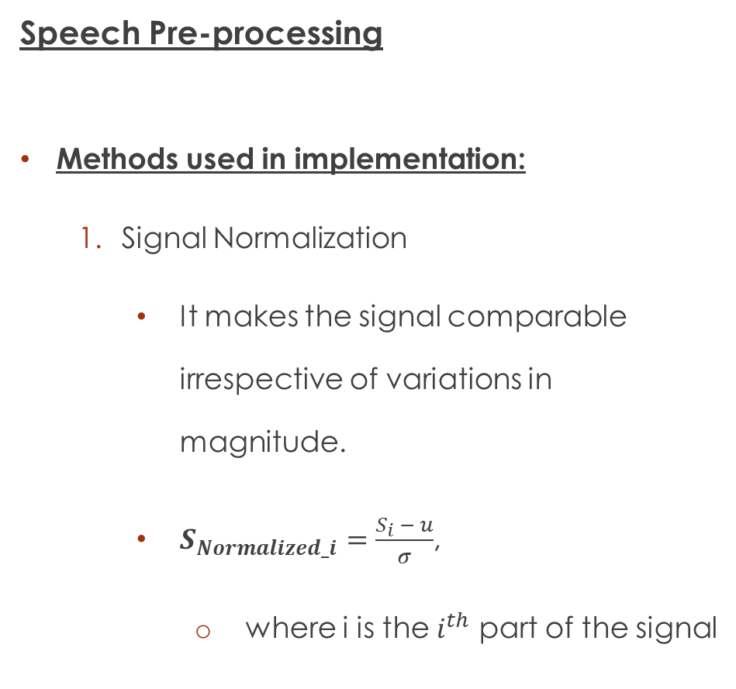
Speech Pre-processing
Methods used in implementation:
Signal Normalization
It makes the signal comparable irrespective of variations in magnitude.
$S_{Normalized_i}=\frac{S_{i} − u}{σ}$,
where i is the $i^{th}$ part of the signal
Figure: Signal before and after Normalization

Slide 5
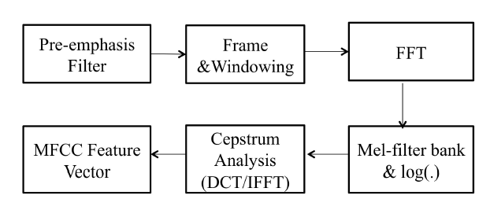
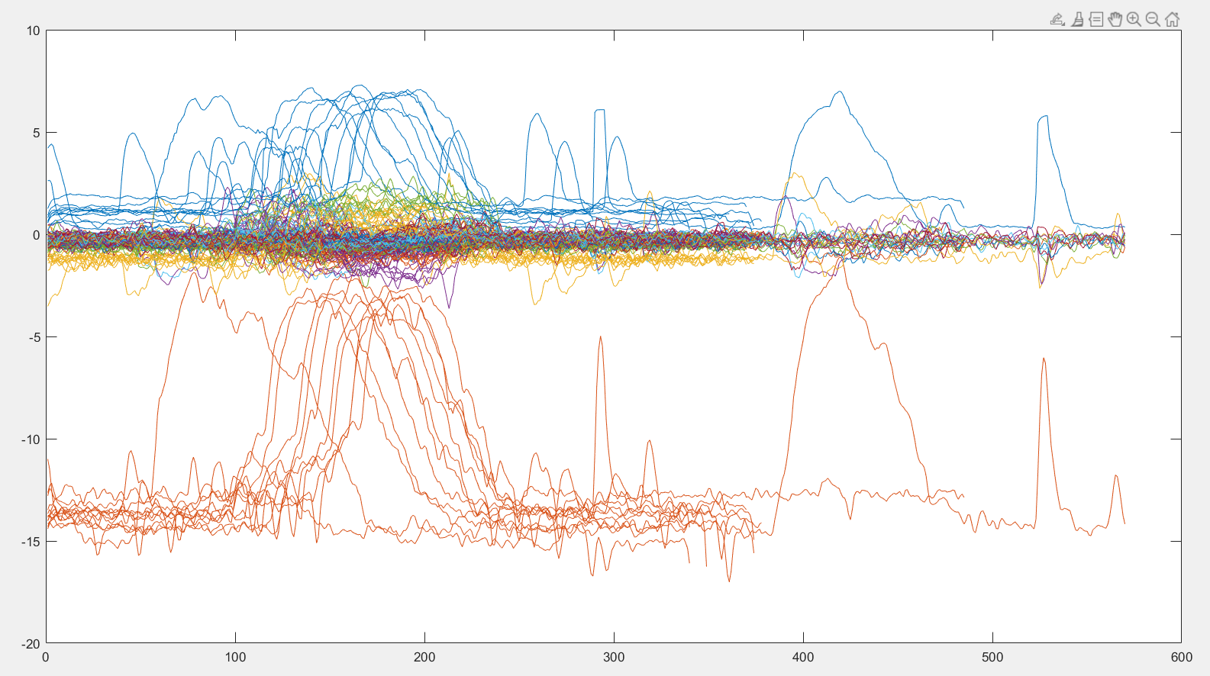
Feature Extraction
Motivation:
if the extracted features correlate well with the class, then classification will be easy and accurate.
MFCC extraction
These features represent the vocal tract information of a speaker.
Figure: Extracted MFCC features process
Figure: Extracted MFCC features

Slide 6
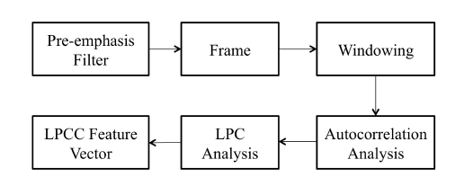
Feature Extraction
LPCC extraction
The LPCC principle is designed upon the model of human speech production.
It applies transfer functions of the glottal, vocal tract, and lips’ filters into one all-pole filter that simulates the vocal tract
Feature extraction process:
LPC analysis and get LPC coefficients
Use Recursive method to get LPCC [1]
Figure: LPCC Extraction process

Slide 7
Feature Extraction
A flowchart that represents feature extraction approach.
Note:
LPCC and MFCC will be concatenated together to form a feature vector which mean more speech features to train the model.
From the normalized averages for MPCC and LPCC, which represents LMACC.
This results in a huge training features matrix for testing and training the model.
Normalizing the features is a good practice.
Figure: Feature extraction process

Slide 8
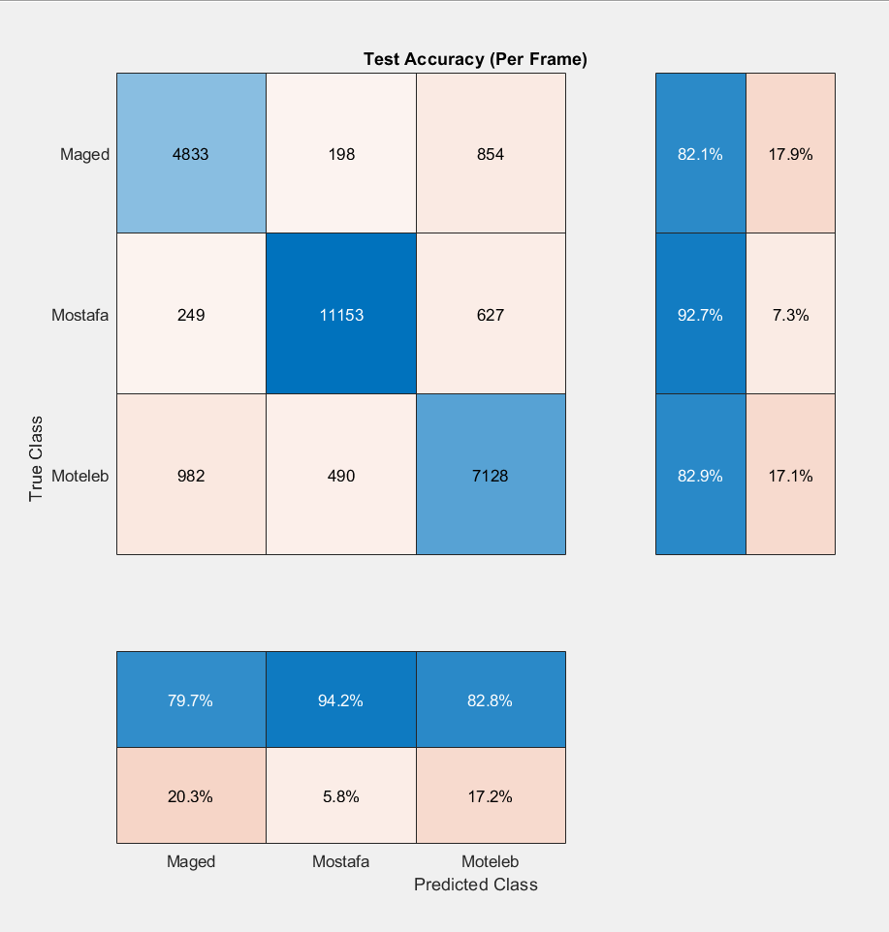
Results and Discussion:
By applying all the previous features and speech preprocessing techniques we go the following results for classification of 3 people.
Moreover, when we scaled the number of users to 10 the system behaved badly and we had to consider only MFCC coefficient with same preprocessing techniques.
Figure: MFCC, LPCC, LMACC features within model testing results

Slide 9
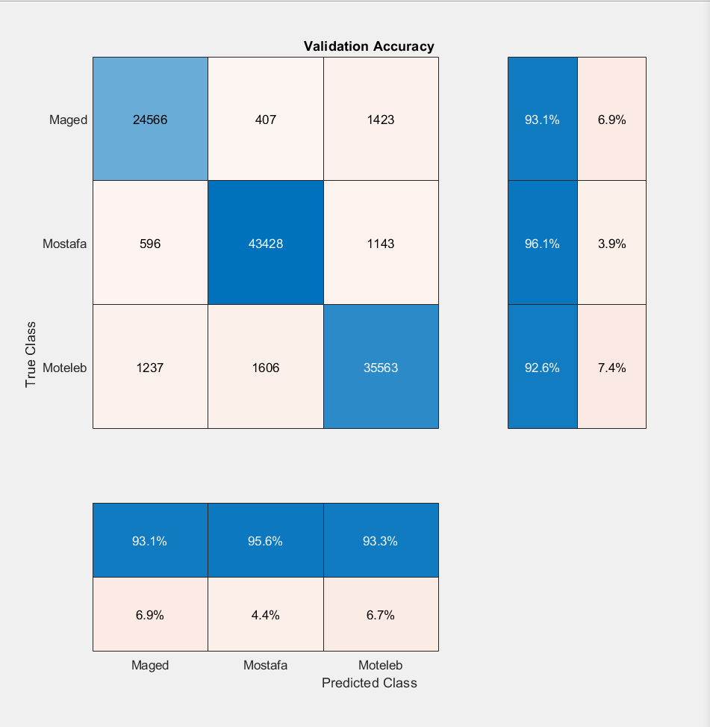
Results and Discussion:
Figure: MFCC, LPCC, LMACC features within model training results
Figure: MFCC, LPCC, LMACC features within model testing results

Slide 10
KNN
K Nearest Neighbor

Slide 11
What is KNN?
It is a type of supervised ML algorithm which can be used for both classification as well as regression predictive problems.
It uses “feature similarity” to predict the values of new datapoints which further means that the new data point will be assigned a value based on how closely it matches the points in the training set.

Slide 12
Tell me who your neighbors are, and I’ll tell you who you are

Slide 13
KNN Algorithm

Slide 14
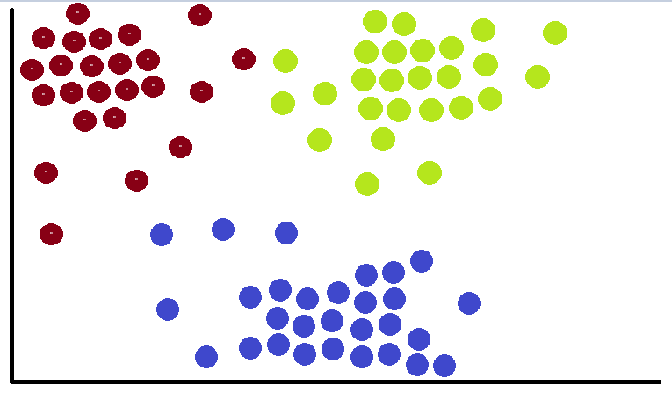
Step1: training set
load the training data set as a reference for the classifier.
As known KNN is a lazy learner algorithm because it does not learn from the training set immediately instead it stores the dataset and at the time of classification, it performs an action on the dataset.

Slide 15
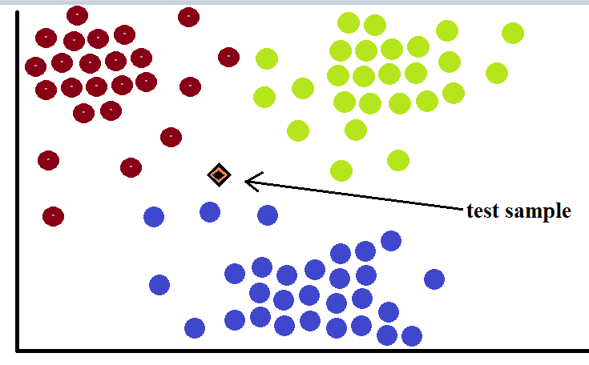
Step2: test sample
Adding a sample to be tested in this classifier to decide to which category it belongs.
All test set is tested and classified in the same way.

Slide 16
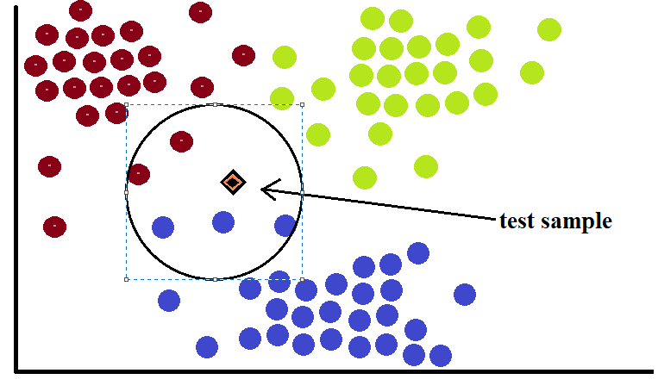
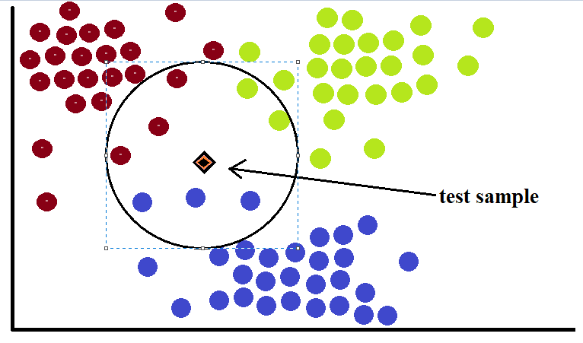
Step3: choosing the best K value
With K=5
With K=8
K is a parameter that refers to the number of nearest neighbors to include in the majority of the voting process.
There is no structured method to find the best value for K. We need to find out with various values by trial and error.
By practicing choosing the value of k is K=sqrt(N) where N is the number of samples in your training dataset.

Slide 17
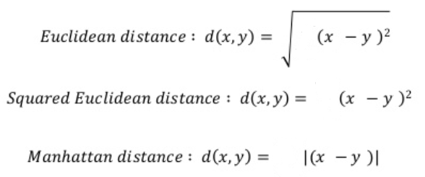
Step4: decision based on distance
Calculate the distance between the test sample and each data point among the K neighbors.
Distance can be calculated in many form such: Manhattan and Euclidean….
Sort the distance and determine the nearest neighbors based of the Kth minimum distance.
Use simple majority of the category of the nearest neighbors as the prediction value of the query instance.

Slide 18
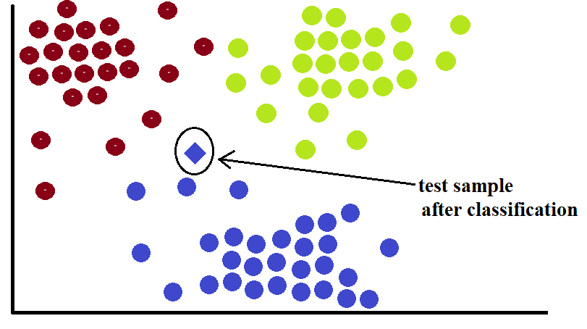
Note
After Applying KNN for K=5
For K=5
3 neighbors of class blue
2 neighbor of class red
So, tested sample would be classified as blue.
For K=8
3 neighbors of class blue
3 neighbor of class red
2 neighbors of class green
It’s confused !!!!
So choosing K with only odd values to avoid confusion between two classes.

Slide 19
Advantages of KNN
Simple and intuitive
No training time
Can learn-non linear functions
Evolves with new data
Single Hyperparameter
Choice of distance metrics

Slide 20
Disadvantages of KNN
Does not work well with large dataset
Does not work well with High dimensional data
KNN Assumes equal importance to all features
Sensitive to outliers

Slide 21
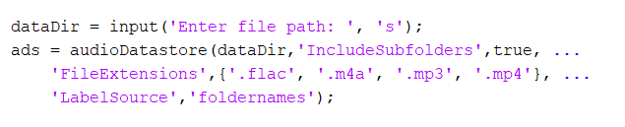
Speakers
Hesham
Menna
Sara
Mahfouz
Mohamed
Mostafa
Moteleb
Nada
Taha
Hajar
Data Set
80 %
20 %
Train
Test
AudioDataStore : Datastore for collection of audio files

Slide 22

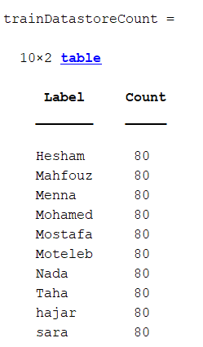
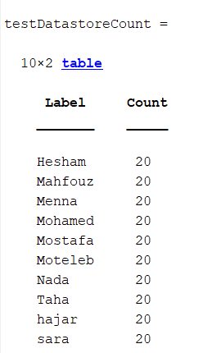
Data Spliting
splitEachLabel : Splits datastore according to specified label proportions
countEachLabel : Count number of unique labels
Train Data
Test Data

Slide 23
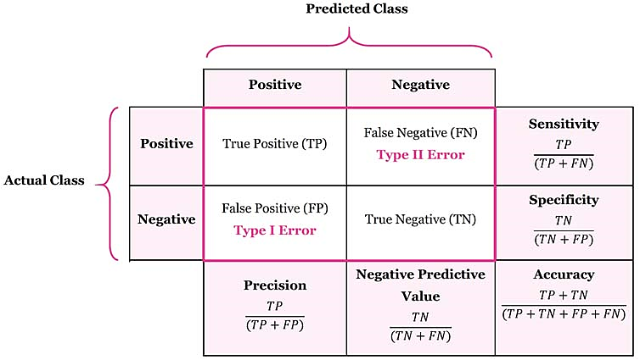
Confusion Matrix
True Positive (TP) : is the number of correct predictions that an example is positive
False Negative (FN) : is the number of incorrect predictions that an example is negative
False positive (FP) : is the number of incorrect predictions that an example is positive
True Negative (TN) : is the number of correct predictions that an example is negative

Slide 24
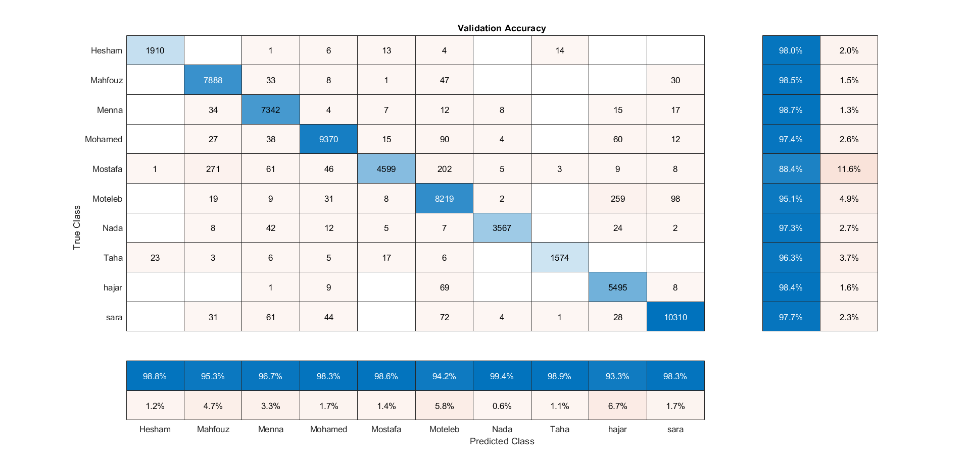
Results

Slide 25
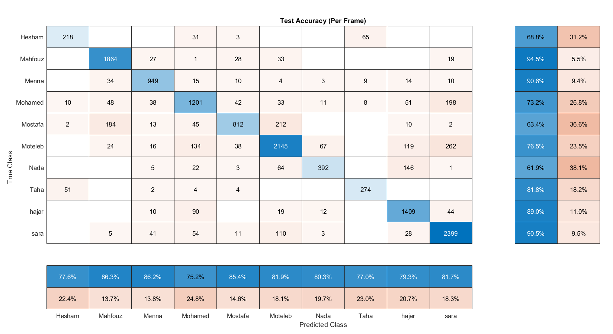

Slide 26
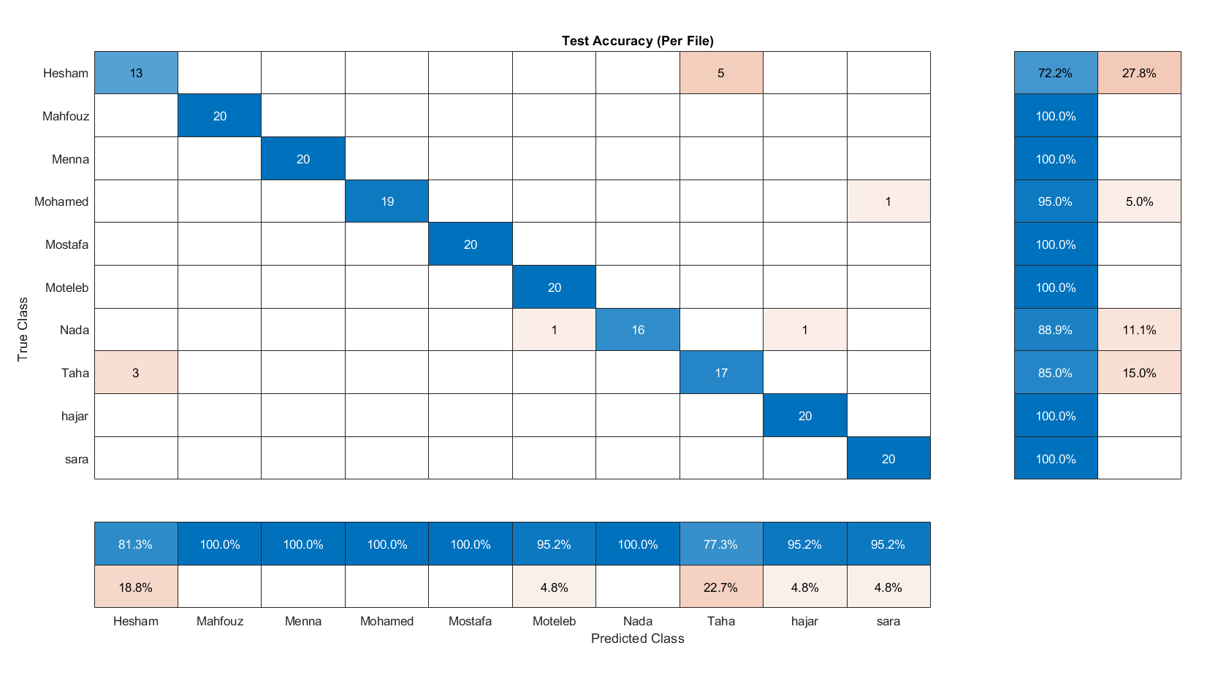

Slide 27
References
[1] Rabiner, L. R. and Juang, B.-H. (1993). Fundamentals of speech recognition.
[2] Elbarougy, R. and Algrbaa, H.A., 2017. Adoption Speaker Recognition System using Mel-frequency Cepstral Coefficients. Journal of Computer Science Approaches, 4 (1).
[3] Jahangir, R., Teh, Y.W., Memon, N.A., Mujtaba, G., Zareei, M., Ishtiaq, U., Akhtar, M.Z. and Ali, I., 2020. Text-Independent Speaker Identification Through Feature Fusion and Deep Neural Network. IEEE Access, 8, pp.32187-32202.
https://machinelearninginterview.com/topics/machine-learning/how-does-knn-algorithm-work-what-are-the-advantages-and-disadvantages-of-knn/
https://www.javatpoint.com/k-nearest-neighbor-algorithm-for-machine-learning?fbclid=IwAR39NmOpuXtx27RWZQzb3ZcO-dQIYfAUql4B-MDj7hHSMiJaKH5EVhEkf0M

